Slide 1
Term Project
Jeel Patel & Jonathan Zheng

Slide 2
Overview
A game where players click a sphere that randomly moves around the screen
Game lasts for 60 seconds and keeps track of player’s score
Once the timer runs out, the game will end and the player’s updated high score will be displayed

Slide 3
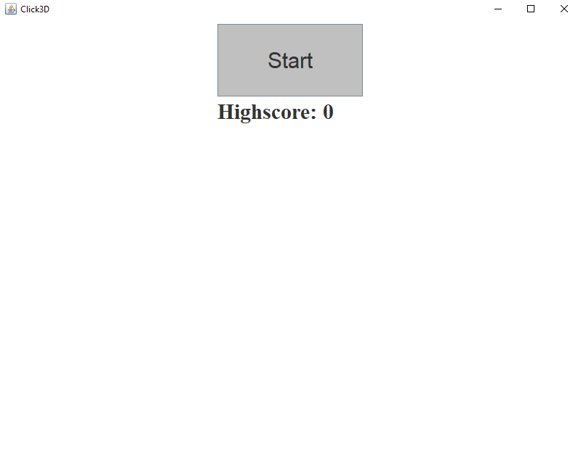
Start Screen Menu
The start screen consists of a “Start” button and a display of current high score
Reads highscore from a file named “highscore.txt”
Clicking the “Start” button will take you to the game screen

Slide 4
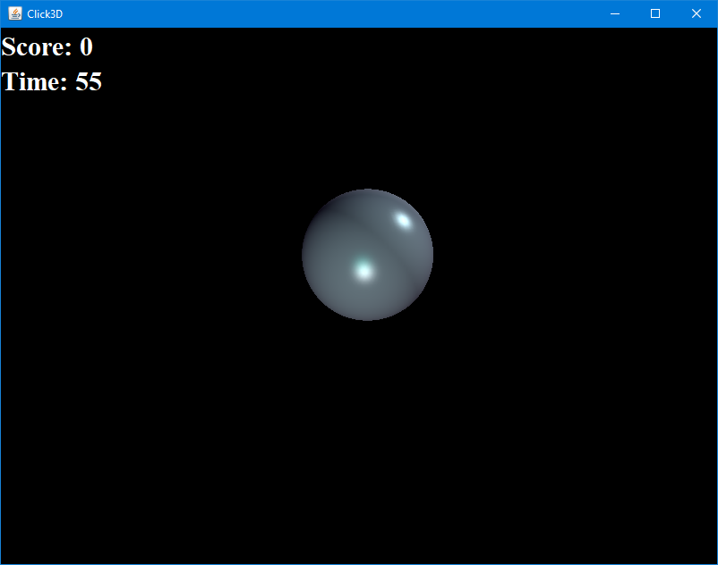
Game Screen - Functionality
The game screen will display current score, time remaining, and a sphere
Each time players click on the
sphere, current score increments and a new sphere is generated
Each game will last for sixty seconds

Slide 5
Game Screen - Sphere
Spheres spawn with random light positions and colors using random values
The sphere will automatically respawn after a few seconds without being clicked
At certain score intervals, the scale of the sphere decreases until it is capped
Spheres will rotate around a random axis

